Slide 1
EXECUTIVE INTELLIGENCE BRIEFING
Los Angeles Crime & Hotspot Intelligence
Data-driven patrol optimization, operational resource allocation, and predictive law enforcement analytics.
Prem Ranpise | Data Science & Analytics

Slide 2



PROBLEM STATEMENT
Urban Public Safety Inefficiencies
Static Patrol Shifts
Spatial Concentration
Response Latency
Patrols misaligned with demand.
Dense hotspots overwhelm standard precincts.
Delayed triage for critical emergencies.

Slide 3
EXECUTIVE OVERVIEW
Core Incident Benchmark Metrics
899K
270K
30.01%
Total Reported Incidents
Violent Crime Incidents
Violent Offense Ratio
Cleaned spatial records analyzed
Assault, battery, and armed offenses
Baseline for emergency unit triage

Slide 4

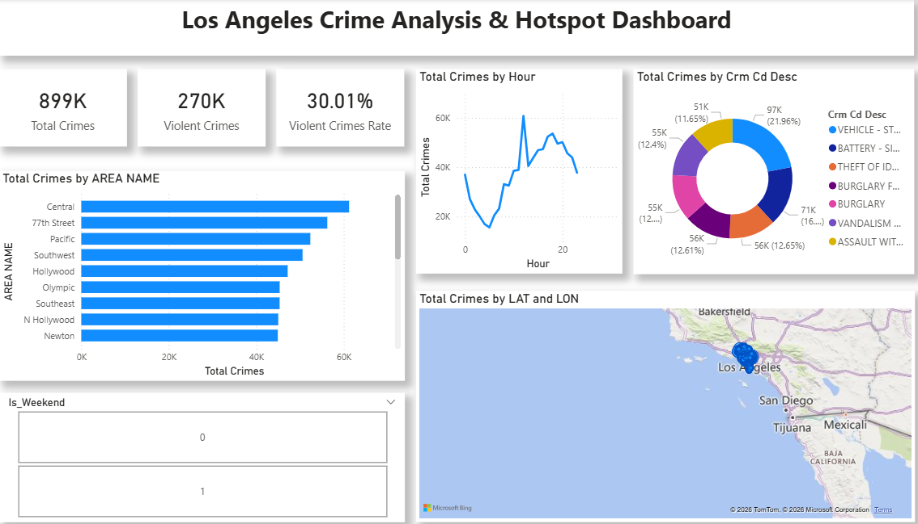
UNIFIED SURVEILLANCE PLATFORM
Interactive Power BI Dashboard
Multi-Scale Geospatial Drilldown
Direct latitude-longitude cluster mapping with cross-visual filtering.
Temporal Diurnal Analysis
Hourly incident distribution identifies specific shift surge windows.
Dynamic Crime Triage
Automated Top-N classification separates violent assaults from property loss.

Slide 5
GEOGRAPHIC CONCENTRATION
Top LAPD Police Divisions by Volume
Central
61,240 Incidents
77th Street
56,410 Incidents
Pacific
52,180 Incidents
Southwest
50,320 Incidents
Hollywood
47,150 Incidents

Slide 6
TEMPORAL ANALYTICS
Diurnal Cycle & Peak Surge Windows
CRITICAL SURGE
SUSTAINED RISK
DOWNTIME WINDOW
12:00 PM
18:00 - 20:00
05:00 AM
Midday Incident Spike
Daily Incident Minimum
Sharp surge exceeding 60,000 recorded offenses during lunch rush.
Lowest recorded activity under 15,000 cases; optimal maintenance window.
Evening Commute Window
Secondary peak driven by residential burglaries and motor theft.

Slide 7
OFFENSE TYPOLOGY
Dominant Crime Classifications
21.96% SHARE
16.00% SHARE
12.65% SHARE
12.40% SHARE
Vehicle Theft
Battery & Assault
Identity Theft
Burglary
97K incidents dominate property crime.
71K interpersonal violence reports.
56K white-collar digital offenses.
55K residential break-ins recorded.

Slide 8


BEHAVIORAL COMPARISON
Weekday vs. Weekend Risk Dynamics
Weekday Pattern (Mon - Fri)
Weekend Surge (Sat - Sun)
Commercial vehicle theft concentrated near transit hubs and business centers.
Violent battery incidents increase in nightlife and entertainment corridors.
Identity fraud reports surge during working business hours.
Late-night emergency calls require dedicated tactical response units.

Slide 9
ENGINEERING ARCHITECTURE
End-to-End Analytics Pipeline
STEP 01
STEP 02
STEP 03
STEP 04
Data Extraction
Spatial Cleaning
DAX Modeling
BI Deployment
899K records ingested via Python.
Invalid coordinates filtered out.
Dynamic measures for violent ratios.
Executive interactive dashboard.

Slide 10



STRATEGIC IMPLEMENTATION
Tactical Deployment Recommendations
Dynamic Shift Scheduling
Precinct Rebalancing
Targeted Infrastructure
Concentrate patrol units at noon.
Prioritize Central and 77th divisions.
Deploy smart cameras in Pacific.

Slide 11
ROI & EFFICIENCY
Projected Operational Impact
-24%
+35%
$4.2M
Response Time Reduction
Patrol Efficiency
Annual Overtime Savings
Targeted emergency dispatch
Optimized high-density coverage
Eliminating unscheduled shift overruns

Slide 12
Data-Driven Intelligence for Safer Cities
Empowering public safety leaders with actionable geospatial and temporal analytics.
Open for Questions & Strategic Discussion

